Slide 1
HDFS (Hadoop Distributed File System)

Slide 2
Hadoop File System was developed using distributed file system design. It is run on commodity hardware.
Unlike other distributed systems, HDFS is highly fault tolerant and designed using low-cost hardware.
HDFS holds very large amount of data and provides easier access.
To store such huge data, the files are stored across multiple machines.
These files are stored in redundant fashion to rescue the system from possible data losses in case of failure.
HDFS also makes applications available to parallel processing.

Slide 3
Features of HDFS
It is suitable for the distributed storage and processing.
Hadoop provides a command interface to interact with HDFS.
The built-in servers of namenode and datanode help users to easily check the status of cluster.
Streaming access to file system data.
HDFS provides file permissions and authentication.

Slide 4
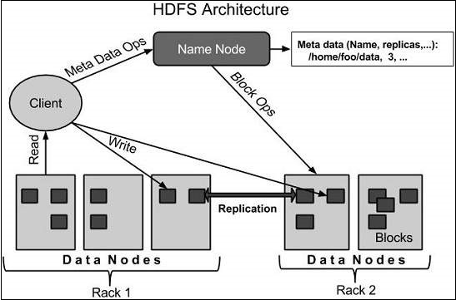

HDFS Architecture
Notes:
WHAT IS A RACK?
A rack is nothing but a collection of 30-40 DataNodes or machines in a Hadoop cluster located in a single data center or location. These DataNodes in a rack are connected to the NameNode through traditional network design via a network switch. A large Hadoop cluster will have multiple racks.

Slide 5
HDFS follows the master-slave architecture, and it has the following elements.
Namenode
The namenode is the commodity hardware that contains the GNU/Linux operating system and the namenode software. It is a software that can be run on commodity hardware. The system having the namenode acts as the master server and it does the following tasks −
Manages the file system namespace.
Regulates client’s access to files.
It also executes file system operations such as renaming, closing, and opening files and directories.

Slide 6
Functions of NameNode:
It is the master daemon that maintains and manages the DataNodes (slave nodes)
It records the metadata of all the files stored in the cluster, e.g. The location of blocks stored, the size of the files, permissions, hierarchy, etc. There are two files associated with the metadata:
FsImage: It contains the complete state of the file system namespace since the start of the NameNode.
EditLogs: It contains all the recent modifications made to the file system with respect to the most recent FsImage.
It records each change that takes place to the file system metadata. For example, if a file is deleted in HDFS, the NameNode will immediately record this in the EditLog.
It regularly receives a Heartbeat and a block report from all the DataNodes in the cluster to ensure that the DataNodes are live.
It keeps a record of all the blocks in HDFS and in which nodes these blocks are located.
The NameNode is also responsible to take care of the replication factor of all the blocks which we will discuss in detail later in this HDFS tutorial blog.
In case of the DataNode failure, the NameNode chooses new DataNodes for new replicas, balance disk usage and manages the communication traffic to the DataNodes.

Slide 7
Datanode
The datanode is a commodity hardware having the GNU/Linux operating system and datanode software. For every node (Commodity hardware/System) in a cluster, there will be a datanode. These nodes manage the data storage of their system.
Datanodes perform read-write operations on the file systems, as per client request.
They also perform operations such as block creation, deletion, and replication according to the instructions of the namenode.

Slide 8
Functions of DataNode:
These are slave daemons or process which runs on each slave machine.
The actual data is stored on DataNodes.
The DataNodes perform the low-level read and write requests from the file system’s clients.
They send heartbeats to the NameNode periodically to report the overall health of HDFS, by default, this frequency is set to 3 seconds.

Slide 9
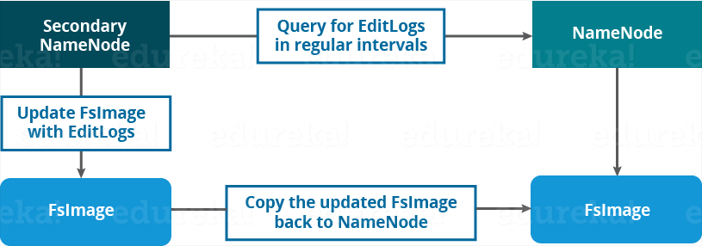
Secondary NameNode:
The Secondary NameNode works concurrently with the primary NameNode as a helper daemon. And don’t be confused about the Secondary NameNode being a backup NameNode because it is not.

Slide 10
Functions of Secondary NameNode:
The Secondary NameNode is one which constantly reads all the file systems and metadata from the RAM of the NameNode and writes it into the hard disk or the file system.
It is responsible for combining the EditLogs with FsImage from the NameNode.
It downloads the EditLogs from the NameNode at regular intervals and applies to FsImage.
The new FsImage is copied back to the NameNode, which is used whenever the NameNode is started the next time.
Hence, Secondary NameNode performs regular checkpoints in HDFS. Therefore, it is also called CheckpointNode.

Slide 11
Block
Generally the user data is stored in the files of HDFS.
The file in a file system will be divided into one or more segments and/or stored in individual data nodes.
These file segments are called as blocks. In other words, the minimum amount of data that HDFS can read or write is called a Block.
The default block size is 64MB, but it can be increased as per the need to change in HDFS configuration.

Slide 12
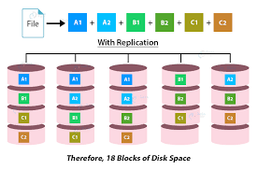
Replication Management:
HDFS provides a reliable way to store huge data in a distributed environment as data blocks.
The blocks are also replicated to provide fault tolerance. The default replication factor is 3 which is again configurable.
So, as you can see in the figure below where each block is replicated three times and stored on different DataNodes (considering the default replication factor):
Notes:
Therefore, if you are storing a file of 128 MB in HDFS using the default configuration, you will end up occupying a space of 384 MB (3*128 MB) as the blocks will be replicated three times and each replica will be residing on a different DataNode
The NameNode collects block report from DataNode periodically to maintain the replication factor. Therefore, whenever a block is over-replicated or under-replicated the NameNode deletes or add replicas as needed.

Slide 13
Rack Awareness:
WHAT IS RACK AWARENESS IN HADOOP HDFS?
The process of making Hadoop aware of what machine is part of which rack and how these racks are connected to each other within the Hadoop cluster is what defines rack awareness.
In a Hadoop cluster, NameNode keeps the rack ids of all the DataNodes. Namenode chooses the closest DataNode while storing the data blocks using the rack information.
In simple terms, having the knowledge of how different data nodes are distributed across the racks or knowing the cluster topology in the Hadoop cluster is called rack awareness in Hadoop. Rack awareness is important as it ensures data reliability and helps to recover data in case of a rack failure.

Slide 14
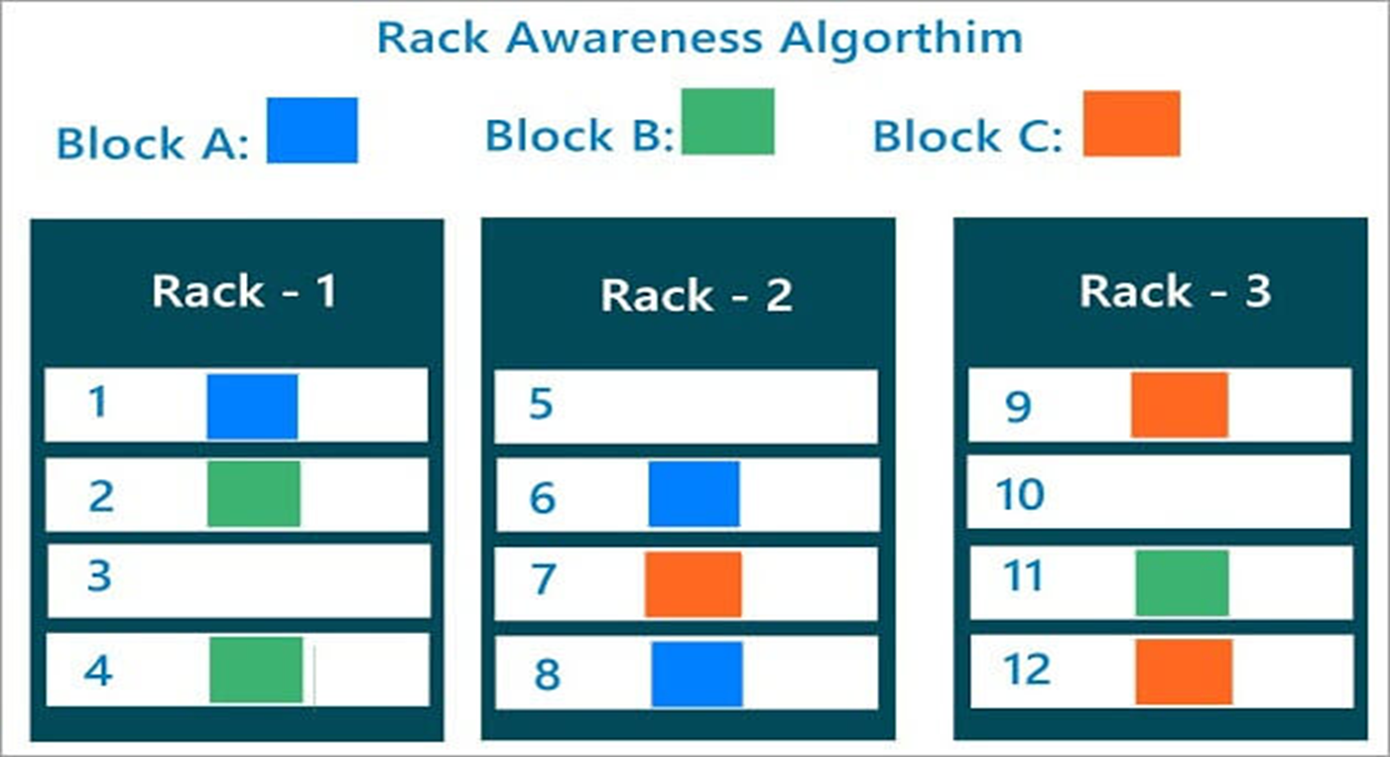

Slide 15
ADVANTAGES OF IMPLEMENTING RACK AWARENESS IN HADOOP
Rack awareness in Hadoop helps optimize replica placement thus ensuring high reliability and fault tolerance.
Rack awareness ensures that the Read/Write requests to replicas are placed to the closest rack or the same rack. This maximizes the reading speed and minimizes the writing cost.
Rack Awareness maximizes the network bandwidth by block transfers within the rack. Data access needs are catered to keeping in mind minimum network travel so as to reduce the network overheads.
Rack Awareness helps the NameNode to assign the task to the nodes closer to data in the network topology.
The MapReduce jobs can also benefit from rack awareness. By knowing where the data required by the map is located, it can run the map task on that particular machine itself, thereby saving a lot of bandwidth and time.

Slide 16
Goals of HDFS
Fault detection and recovery − Since HDFS includes a large number of commodity hardware, failure of components is frequent. Therefore, HDFS should have mechanisms for quick and automatic fault detection and recovery.
Huge datasets − HDFS should have hundreds of nodes per cluster to manage the applications having huge datasets.
Hardware at data − A requested task can be done efficiently, when the computation takes place near the data. Especially where huge datasets are involved, it reduces the network traffic and increases the throughput.

Slide 17
HDFS Read/ Write Architecture:
HDFS Write Architecture:
Suppose a situation where an HDFS client, wants to write a file named “example.txt” of size 248 MB.
Assume that the system block size is configured for 128 MB (default). So, the client will be dividing the file “example.txt” into 2 blocks – one of 128 MB (Block A) and the other of 120 MB (block B).
At first, the HDFS client will reach out to the NameNode for a Write Request against the two blocks, say, Block A & Block B.
The NameNode will then grant the client the write permission and will provide the IP addresses of the DataNodes where the file blocks will be copied eventually.
The selection of IP addresses of DataNodes is purely randomized based on availability, replication factor and rack awareness.
Let’s say the replication factor is set to default i.e. 3. Therefore, for each block the NameNode will be providing the client a list of (3) IP addresses of DataNodes. The list will be unique for each block.

Slide 18
Suppose, the NameNode provided following lists of IP addresses to the client:
For Block A, list A = {IP of DataNode 1, IP of DataNode 4, IP of DataNode 6}
For Block B, set B = {IP of DataNode 3, IP of DataNode 7, IP of DataNode 9}
Each block will be copied in three different DataNodes to maintain the replication factor consistent throughout the cluster.

Slide 19
Data Write (Copying of data)
Set up of Pipeline
Data streaming and replication
Shutdown of Pipeline (Acknowledgement stage)

Slide 20
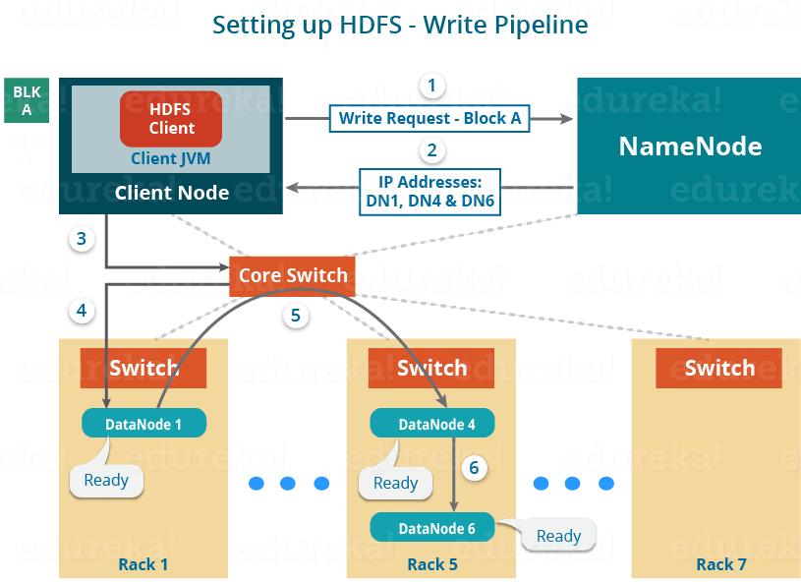
1. Set up of Pipeline:
For Block A, list A = {IP of DataNode 1, IP of DataNode 4, IP of DataNode 6}.
Notes:
Before writing the blocks, the client confirms whether the DataNodes, present in each of the list of IPs, are ready to receive the data or not.
In doing so, the client creates a pipeline for each of the blocks by connecting the individual DataNodes in the respective list for that block. Let us consider Block A. The list of DataNodes provided by the NameNode is:

Slide 21
Steps to create a pipeline:
The client will choose the first DataNode in the list (DataNode IPs for Block A) which is DataNode 1 and will establish a TCP/IP connection.
The client will inform DataNode 1 to be ready to receive the block. It will also provide the IPs of next two DataNodes (4 and 6) to the DataNode 1 where the block is supposed to be replicated.
The DataNode 1 will connect to DataNode 4. The DataNode 1 will inform DataNode 4 to be ready to receive the block and will give it the IP of DataNode 6. Then, DataNode 4 will tell DataNode 6 to be ready for receiving the data.
Next, the acknowledgement of readiness will follow the reverse sequence, i.e. From the DataNode 6 to 4 and then to 1.
At last DataNode 1 will inform the client that all the DataNodes are ready and a pipeline will be formed between the client, DataNode 1, 4 and 6.
Now pipeline set up is complete and the client will finally begin the data copy or streaming process.

Slide 22
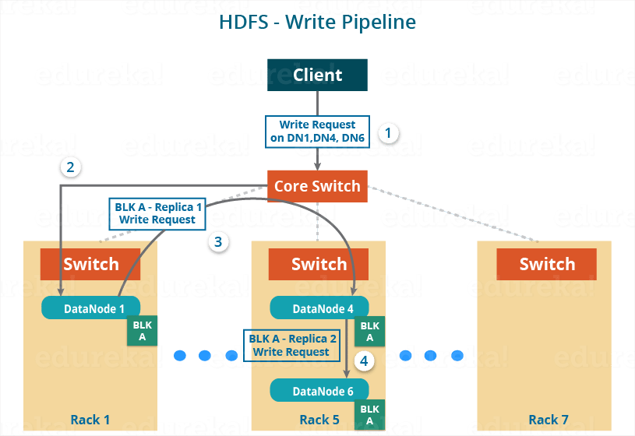
2. Data Streaming:
Notes:
As the pipeline has been created, the client will push the data into the pipeline. Now, don’t forget that in HDFS, data is replicated based on replication factor. So, here Block A will be stored to three DataNodes as the assumed replication factor is 3. Moving ahead, the client will copy the block (A) to DataNode 1 only. The replication is always done by DataNodes sequentially.

Slide 23
So, the following steps will take place during replication:
Once the block has been written to DataNode 1 by the client, DataNode 1 will connect to DataNode 4.
Then, DataNode 1 will push the block in the pipeline and data will be copied to DataNode 4.
Again, DataNode 4 will connect to DataNode 6 and will copy the last replica of the block.

Slide 24
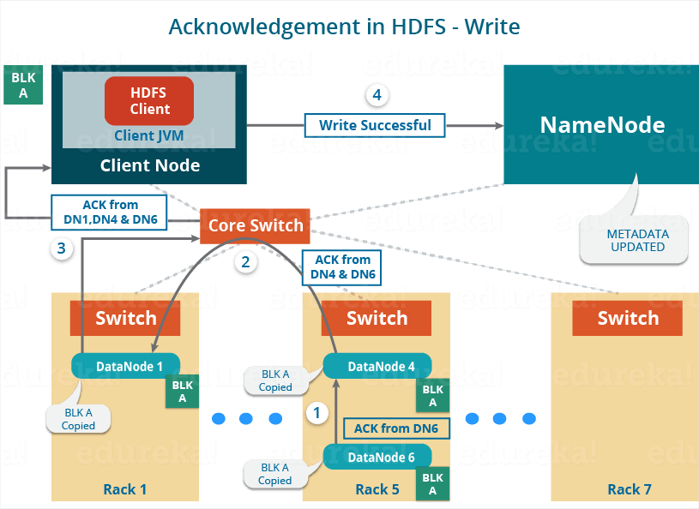
3. Shutdown of Pipeline or Acknowledgement stage:
Once the block has been copied into all the three DataNodes, a series of acknowledgements will take place to ensure the client and NameNode that the data has been written successfully. Then, the client will finally close the pipeline to end the TCP session.
As shown in the figure the acknowledgement happens in the reverse sequence i.e., from DataNode 6 to 4 and then to 1. Finally, the DataNode 1 will push three acknowledgements (including its own) into the pipeline and send it to the client. The client will inform NameNode that data has been written successfully. The NameNode will update its metadata and the client will shut down the pipeline.

Slide 25
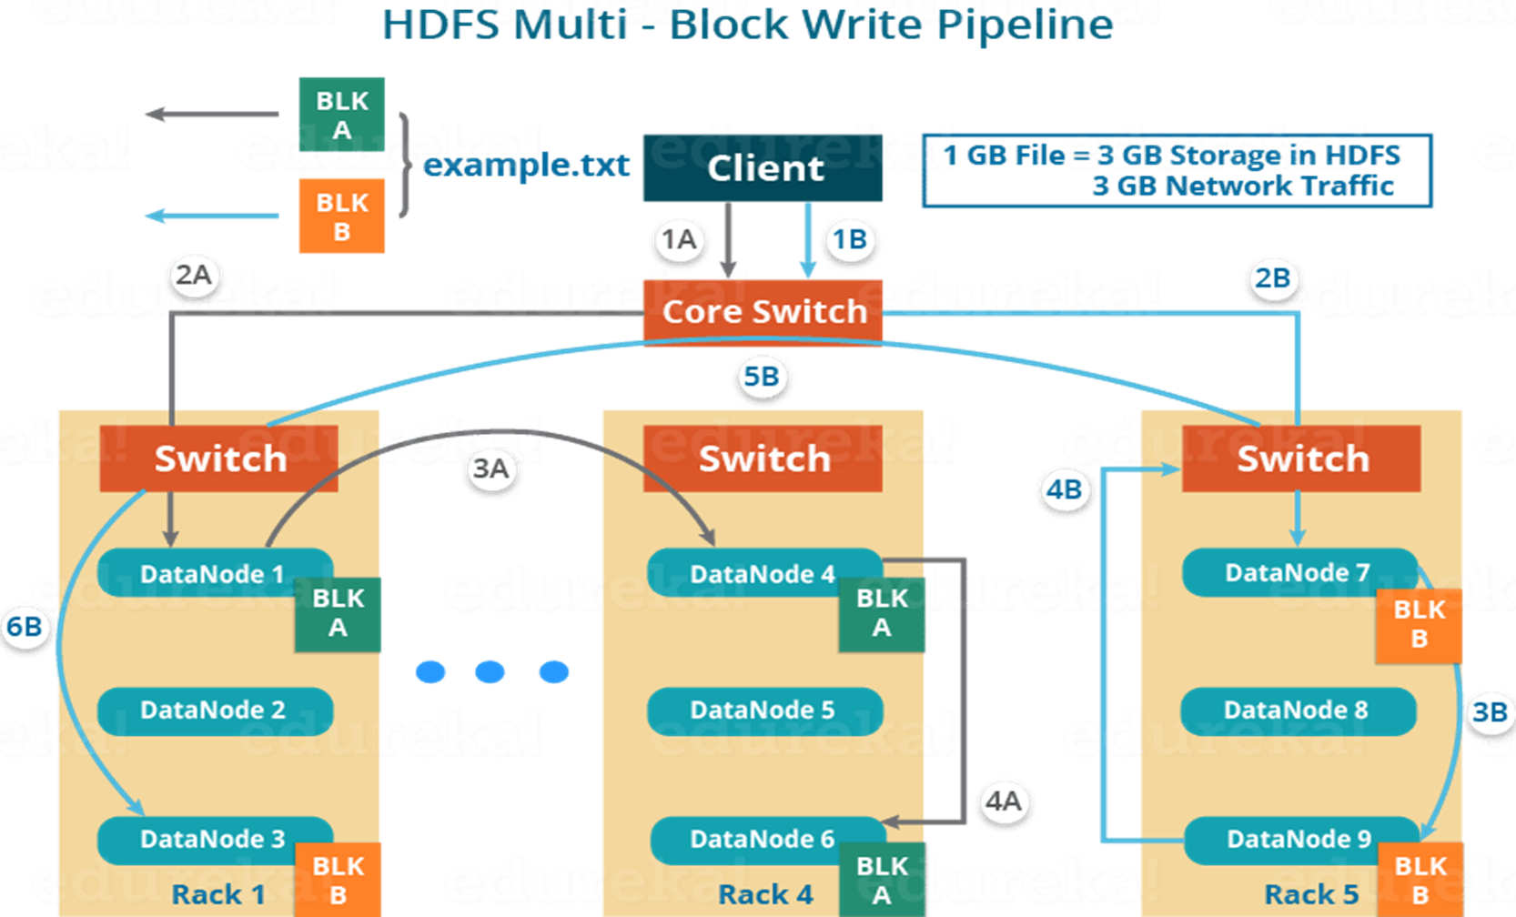
Block B will also be copied into the DataNodes in parallel with Block A. So, the following things are to be noticed here:
The client will copy Block A and Block B to the first DataNode simultaneously.
Therefore, in our case, two pipelines will be formed for each of the block and all the process discussed above will happen in parallel in these two pipelines.
The client writes the block into the first DataNode and then the DataNodes will be replicating the block sequentially.
Notes:
As you can see in the above image, there are two pipelines formed for each block (A and B). Following is the flow of operations that is taking place for each block in their respective pipelines:
For Block A: 1A -> 2A -> 3A -> 4A
For Block B: 1B -> 2B -> 3B -> 4B -> 5B -> 6B

Slide 26
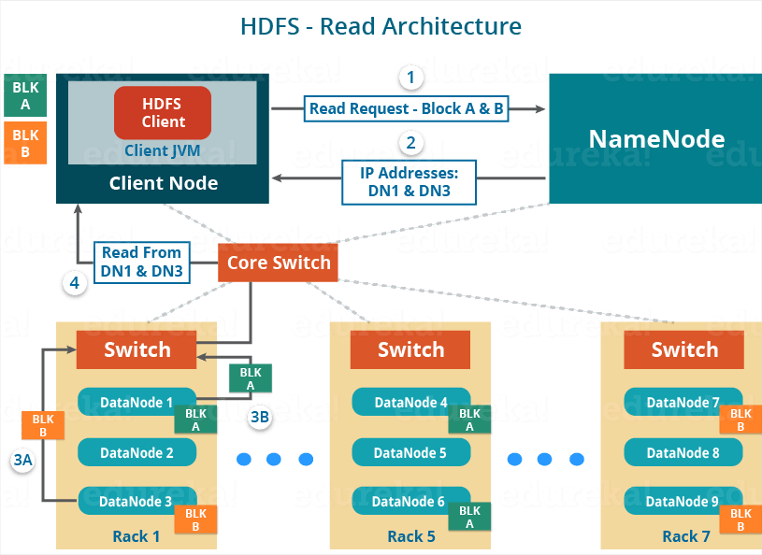
HDFS Read Architecture:
Notes:
HDFS Read architecture is comparatively easy to understand. Let’s take the above example again where the HDFS client wants to read the file “example.txt” now.

Slide 27
The client will reach out to NameNode asking for the block metadata for the file “example.txt”.
The NameNode will return the list of DataNodes where each block (Block A and B) are stored.
After that client, will connect to the DataNodes where the blocks are stored.
The client starts reading data parallel from the DataNodes (Block A from DataNode 1 and Block B from DataNode 3).
Once the client gets all the required file blocks, it will combine these blocks to form a file.
Notes:
While serving read request of the client, HDFS selects the replica which is closest to the client. This reduces the read latency and the bandwidth consumption. Therefore, that replica is selected which resides on the same rack as the reader node, if possible.

